Slide 1
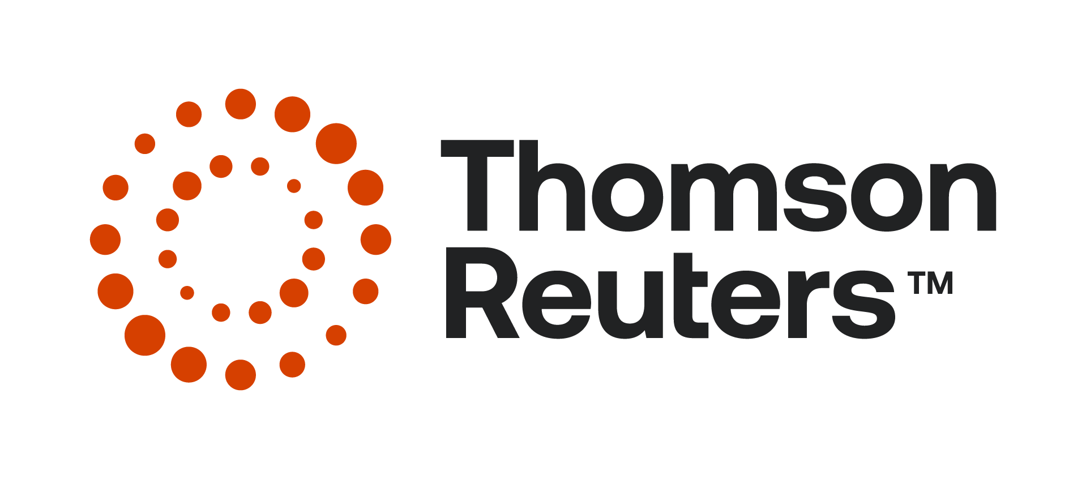
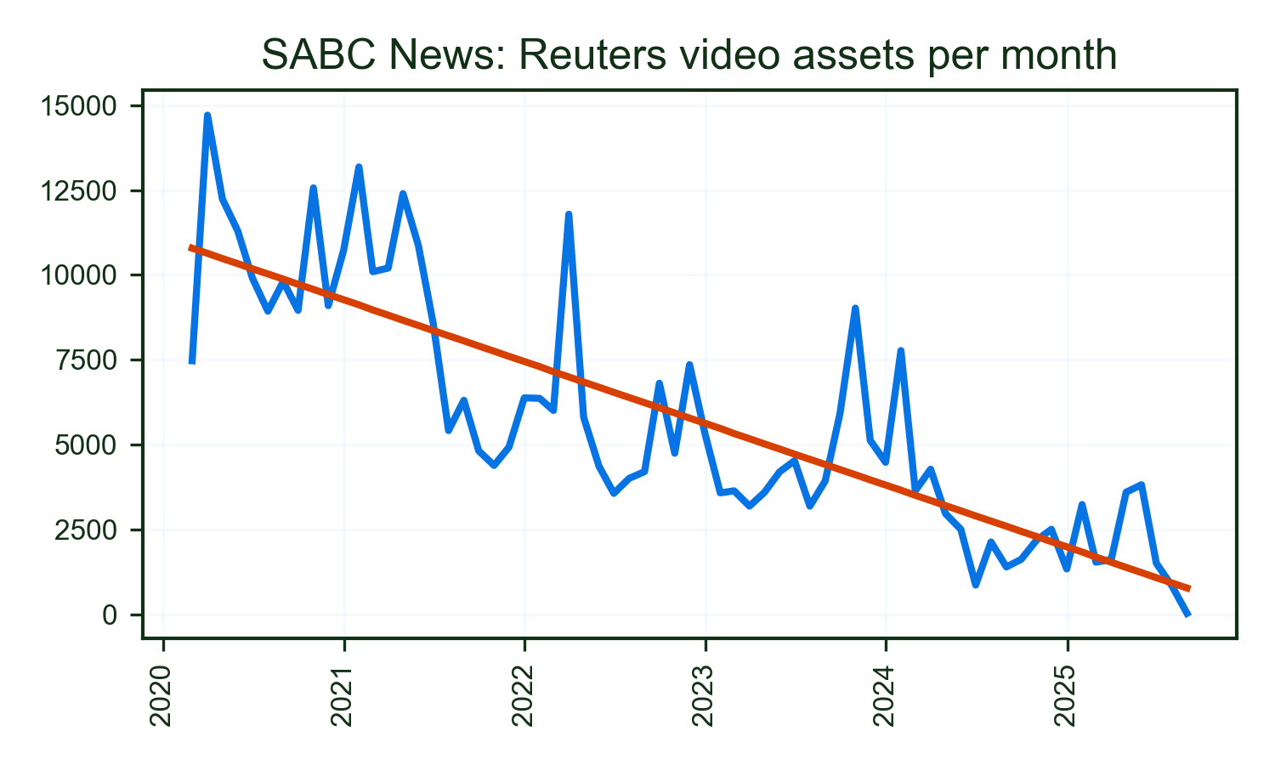
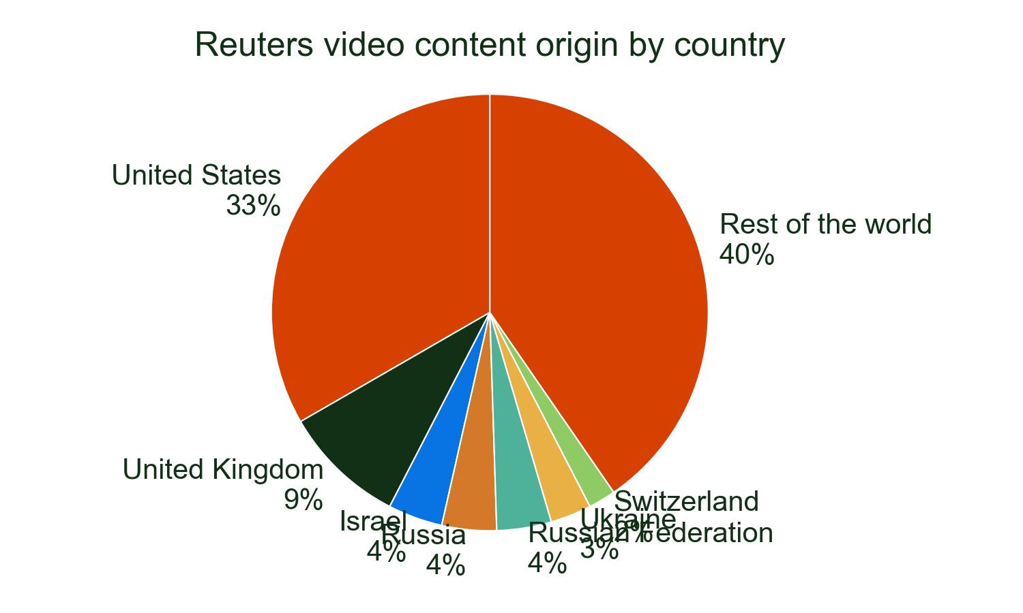
SABC News's use of Reuters video progressed its gentle downwards trend in 2025, which has seen baseline usage gentle in the last 5 years.
It remains very reliant on Reuters video for coverage from the US and used nearly 387,231 video assets from 1 countries.
Major stories
• HEALTH: 16.5%
• USA: 6.5%
• ISRAEL: 6.1%
Of all detections of Reuters video on SABC News in 2025.

